Slide 1
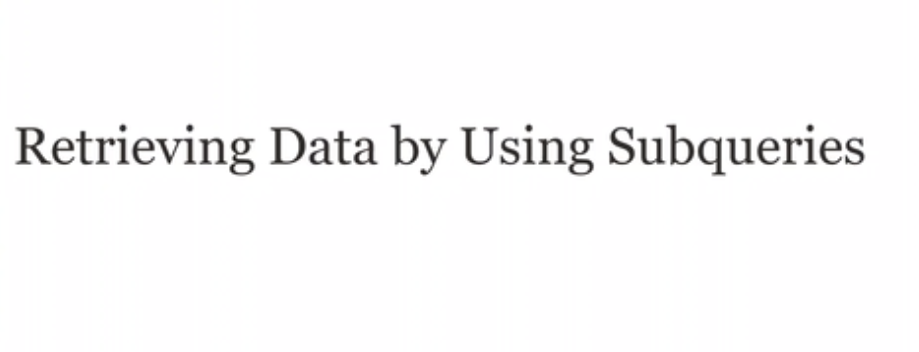

Slide 2
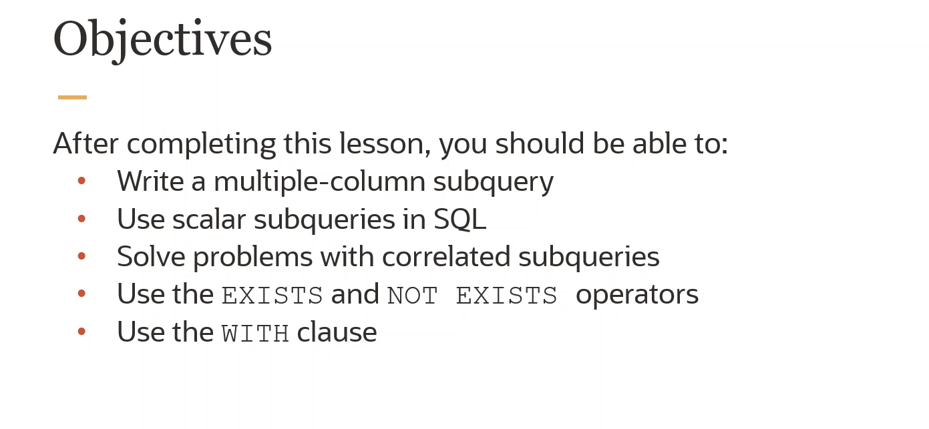

Slide 3
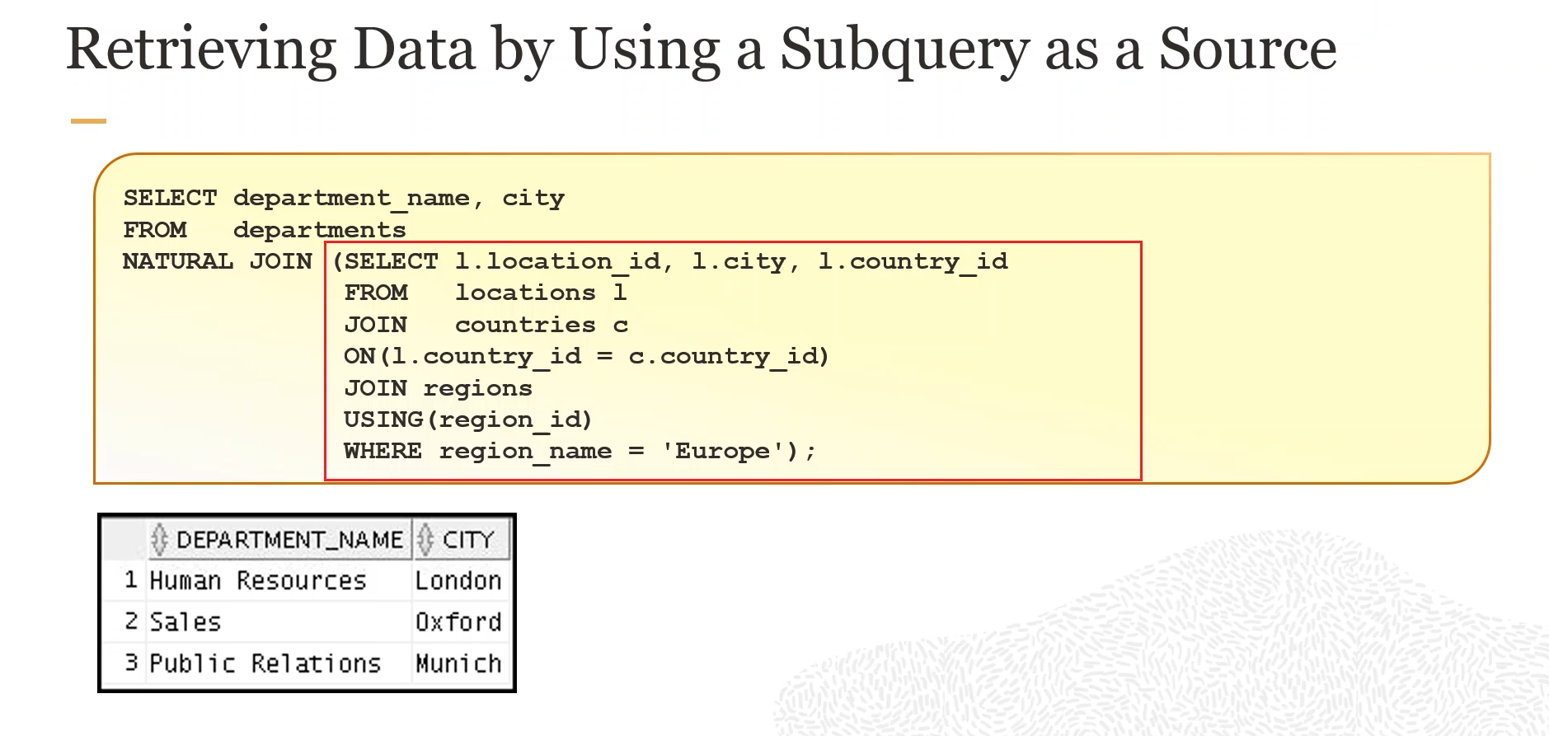

Slide 4


Slide 5
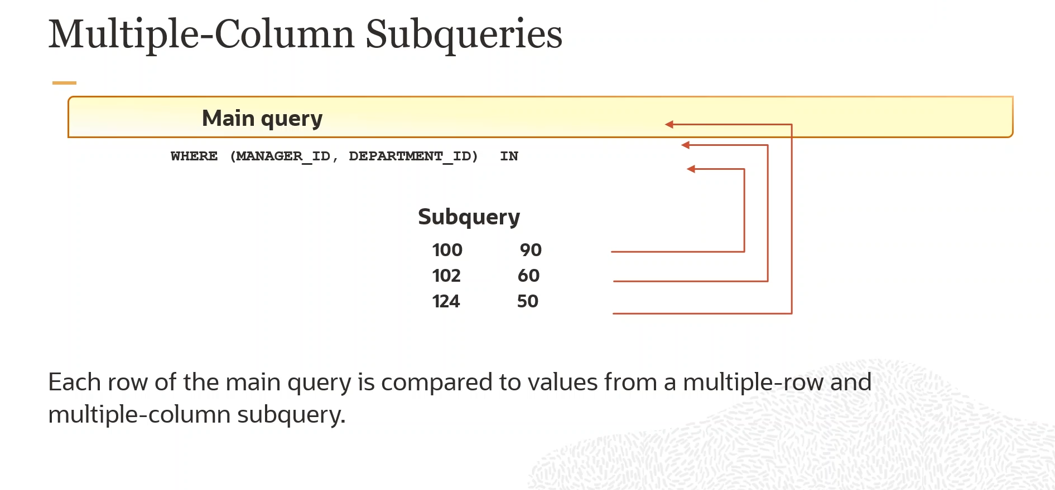

Slide 6
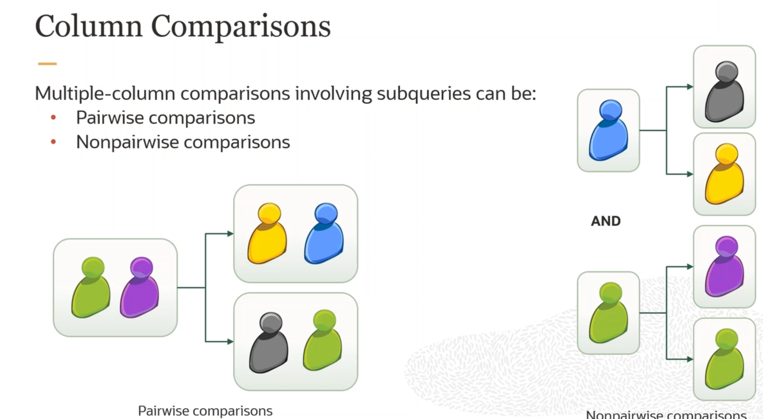

Slide 7
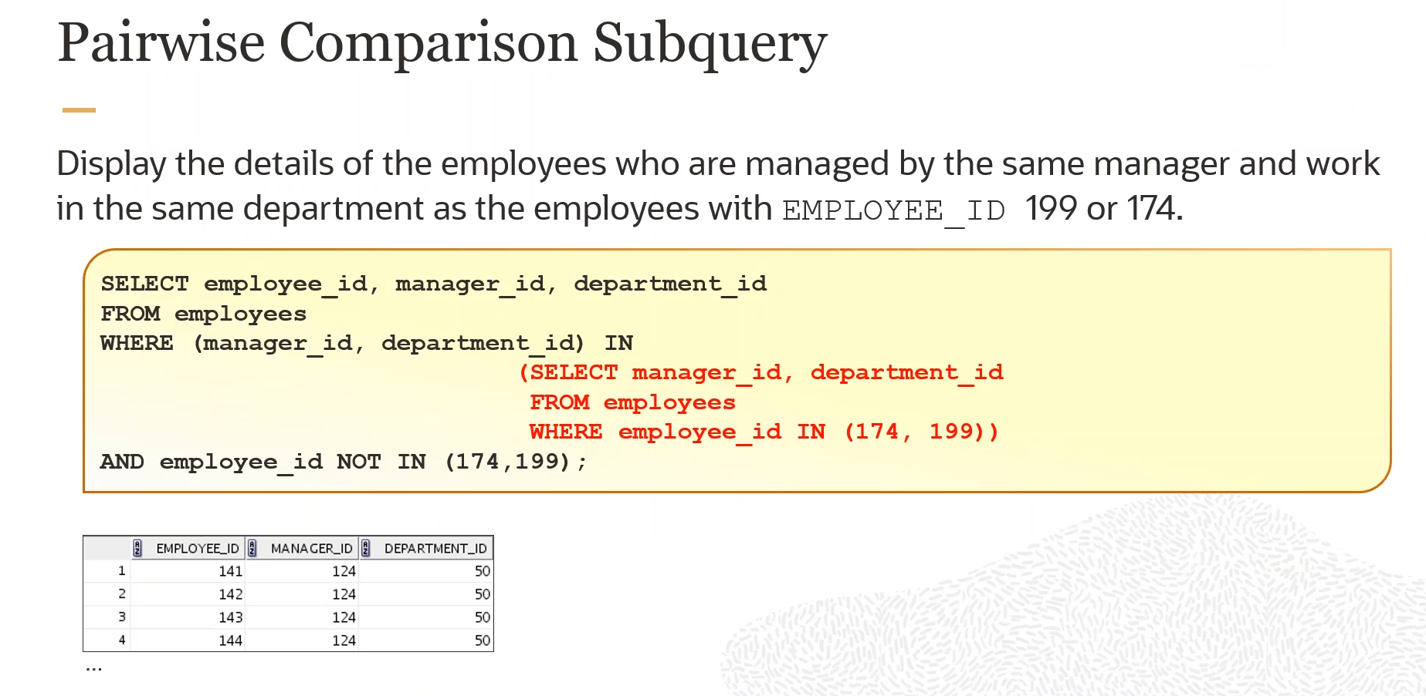

Slide 8
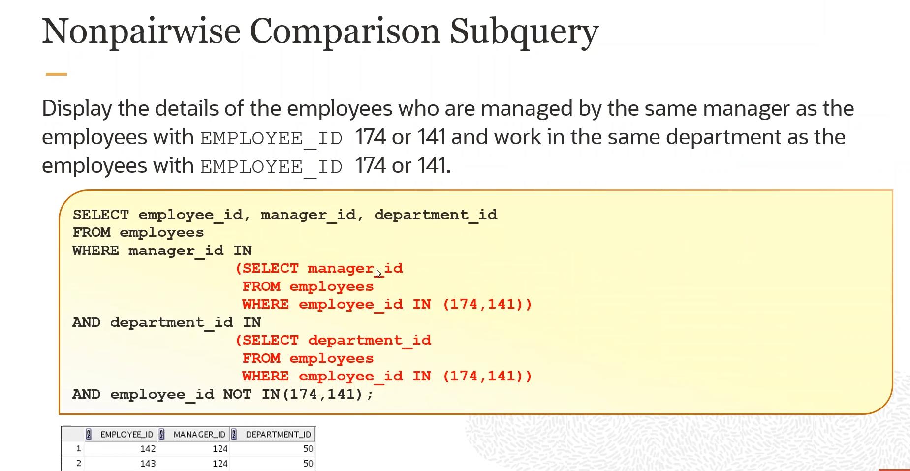

Slide 9
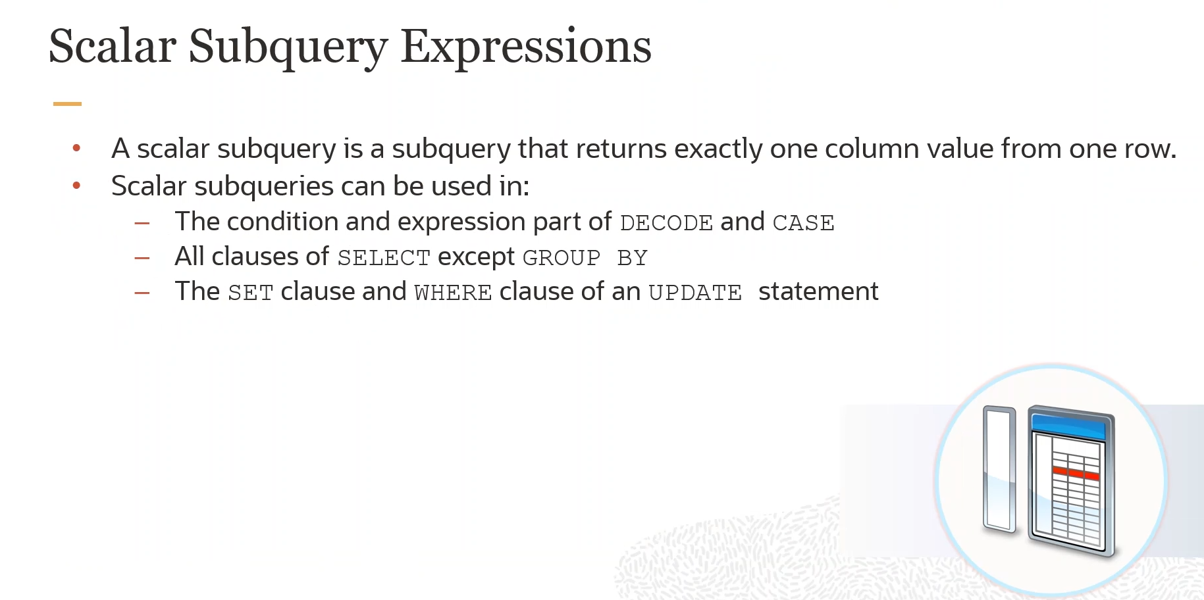

Slide 10
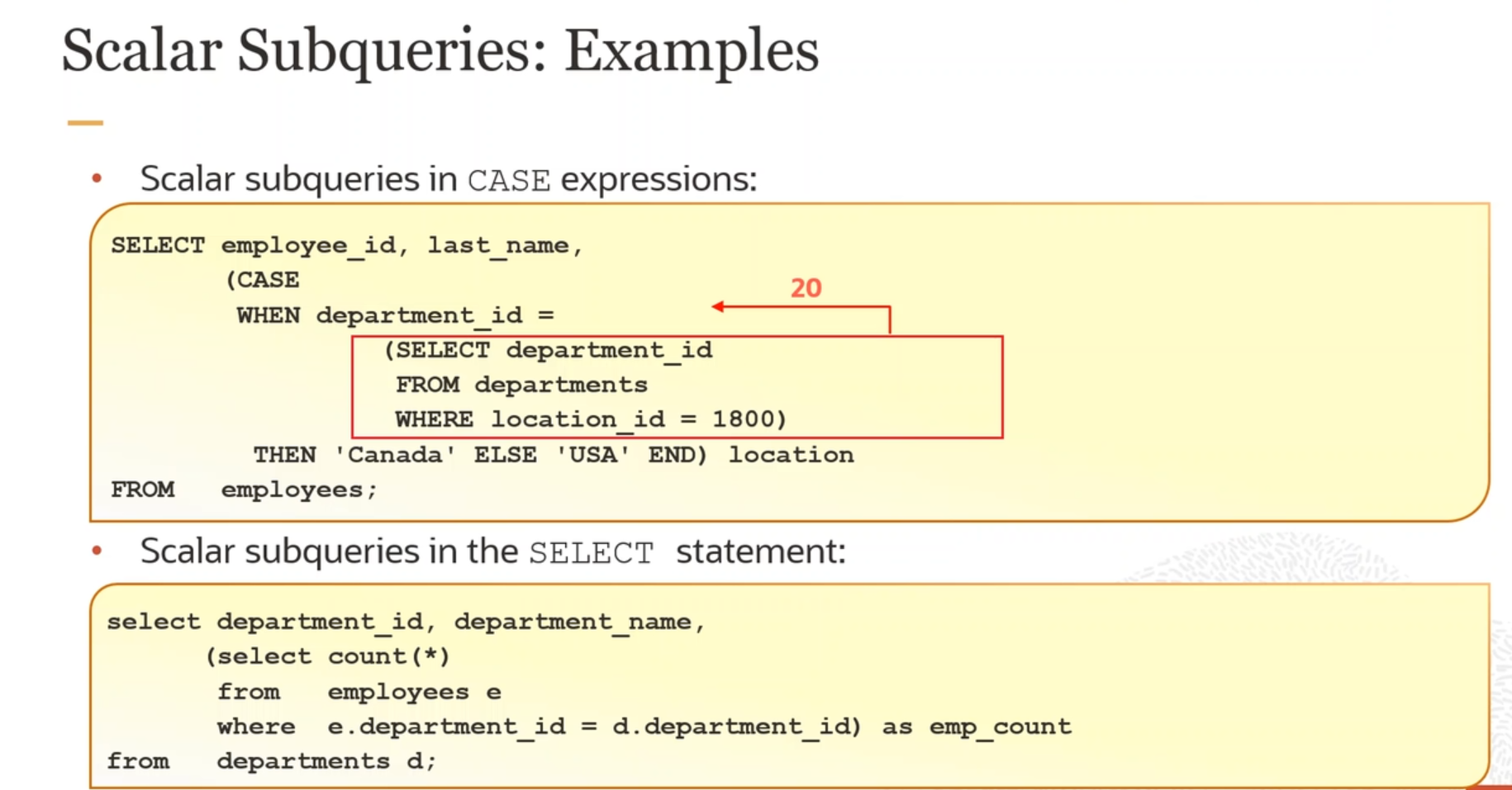

Slide 11


Slide 12
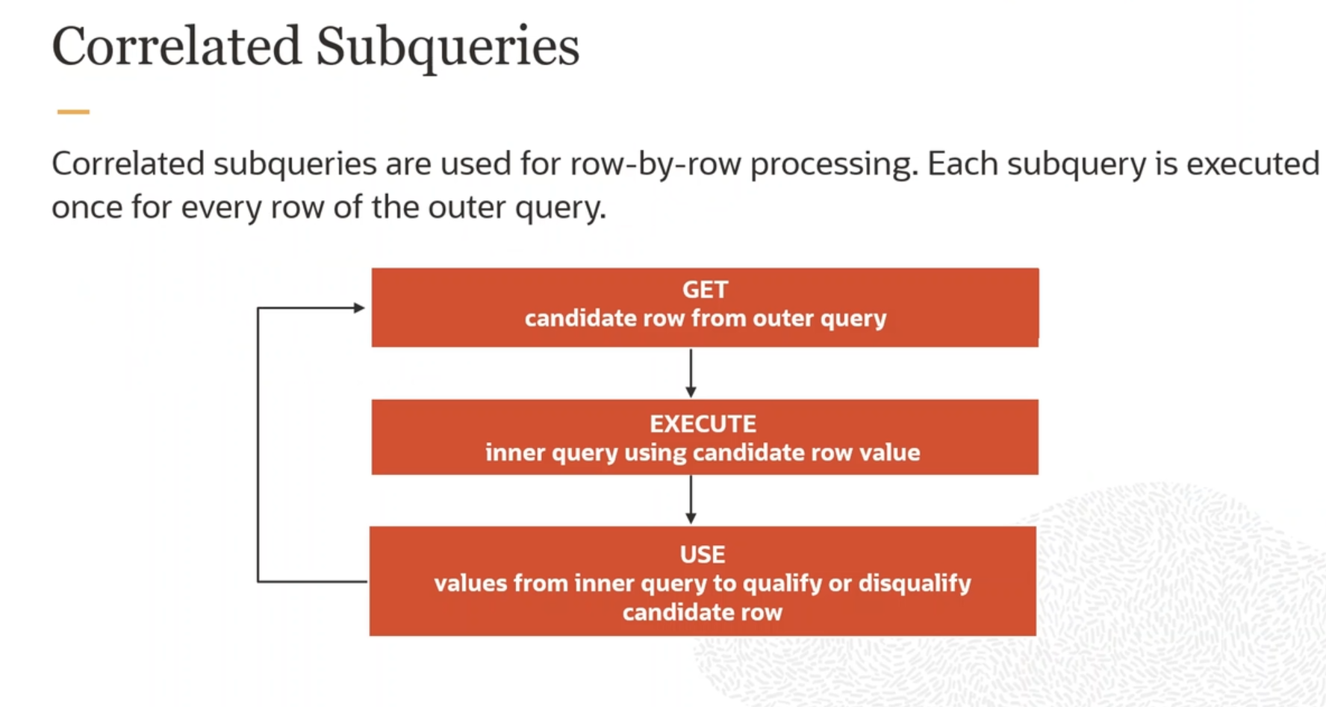

Slide 13
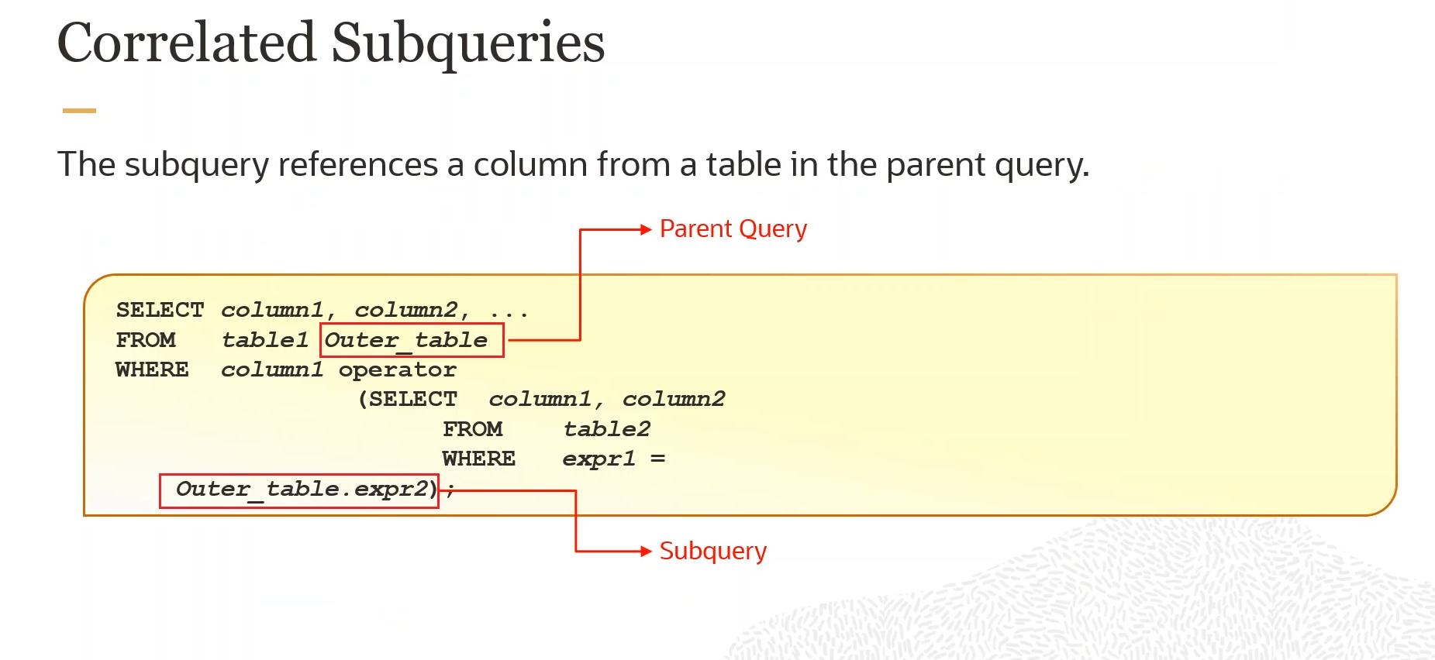

Slide 14
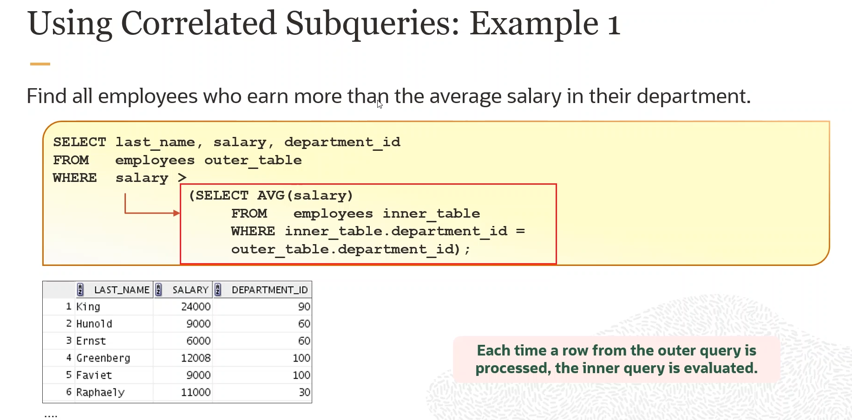

Slide 15
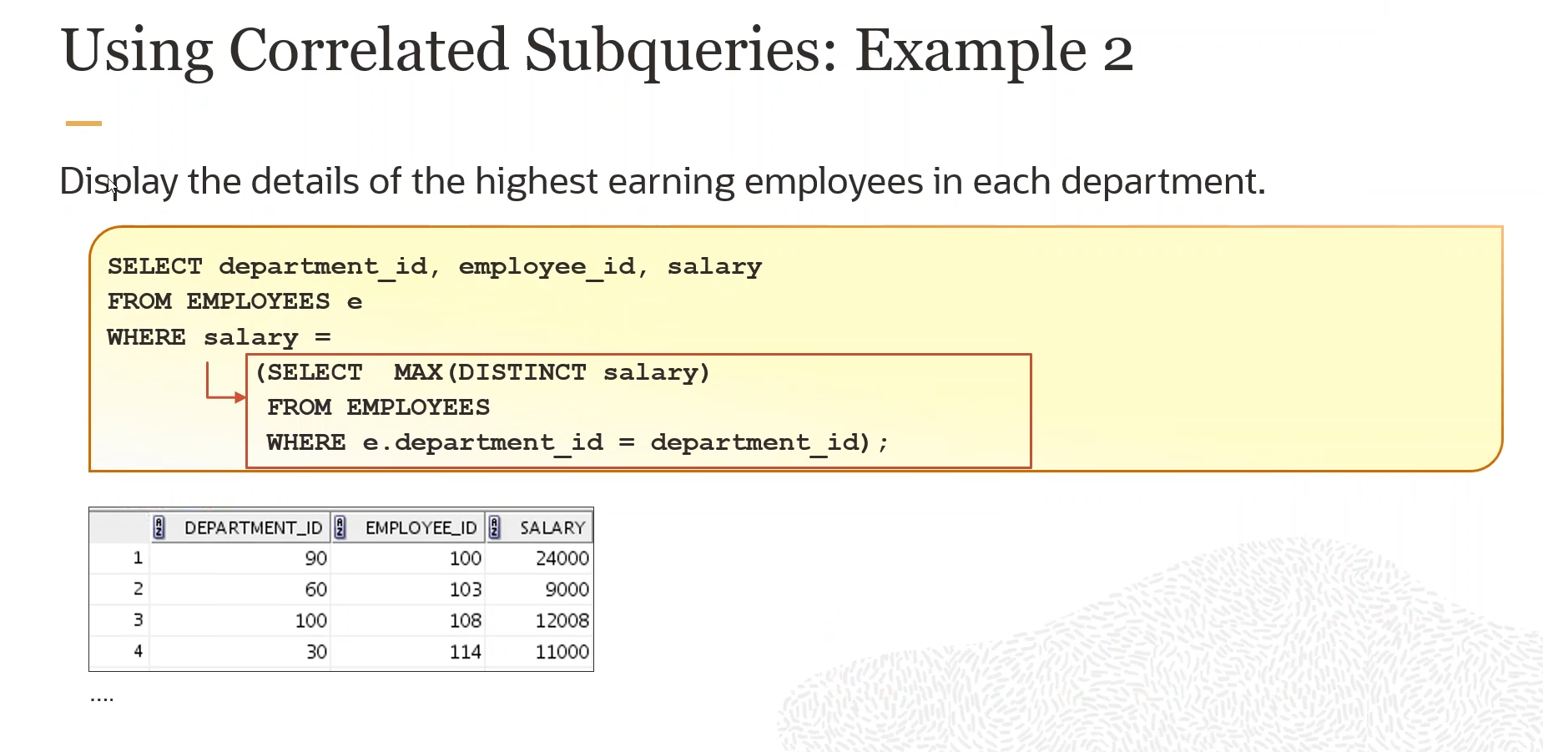

Slide 16
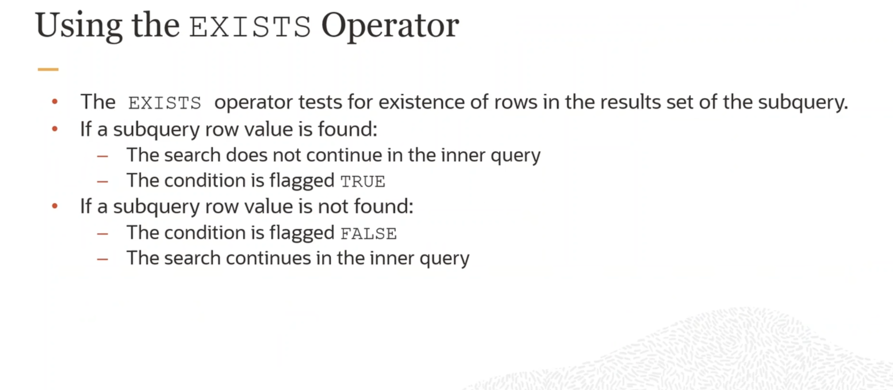

Slide 17
Syntax
SELECT column_name(s) FROM table_name WHERE EXISTS (SELECT column_name FROM table_name WHERE condition);

Slide 18
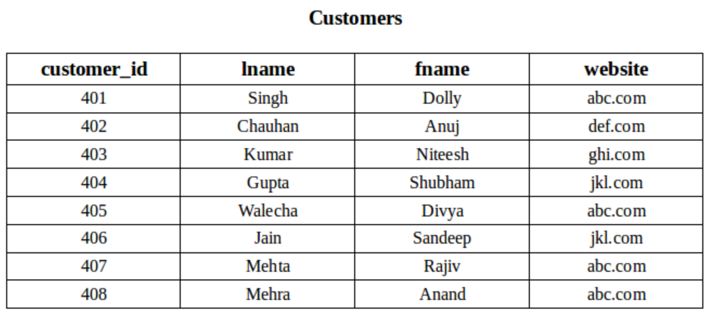
Examples: Consider the following two relation “Customers” and “Orders”.

Slide 19
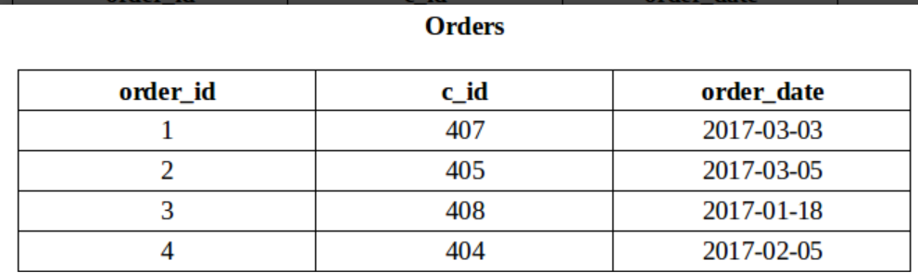
Orders Table

Slide 20
Using EXISTS condition with SELECT statement To fetch the first and last name of the customers who placed at least one order.
SELECT fname, lname FROM Customers WHERE EXISTS
(SELECT * FROM Orders WHERE Customers.customer_id = Orders.c_id);

Slide 21
Using NOT with EXISTS Fetch last and first name of the customers who has not placed any order.
SELECT lname, fname FROM Customers WHERE NOT EXISTS
(SELECT * FROM Orders WHERE Customers.customer_id = Orders.c_id);

Slide 22
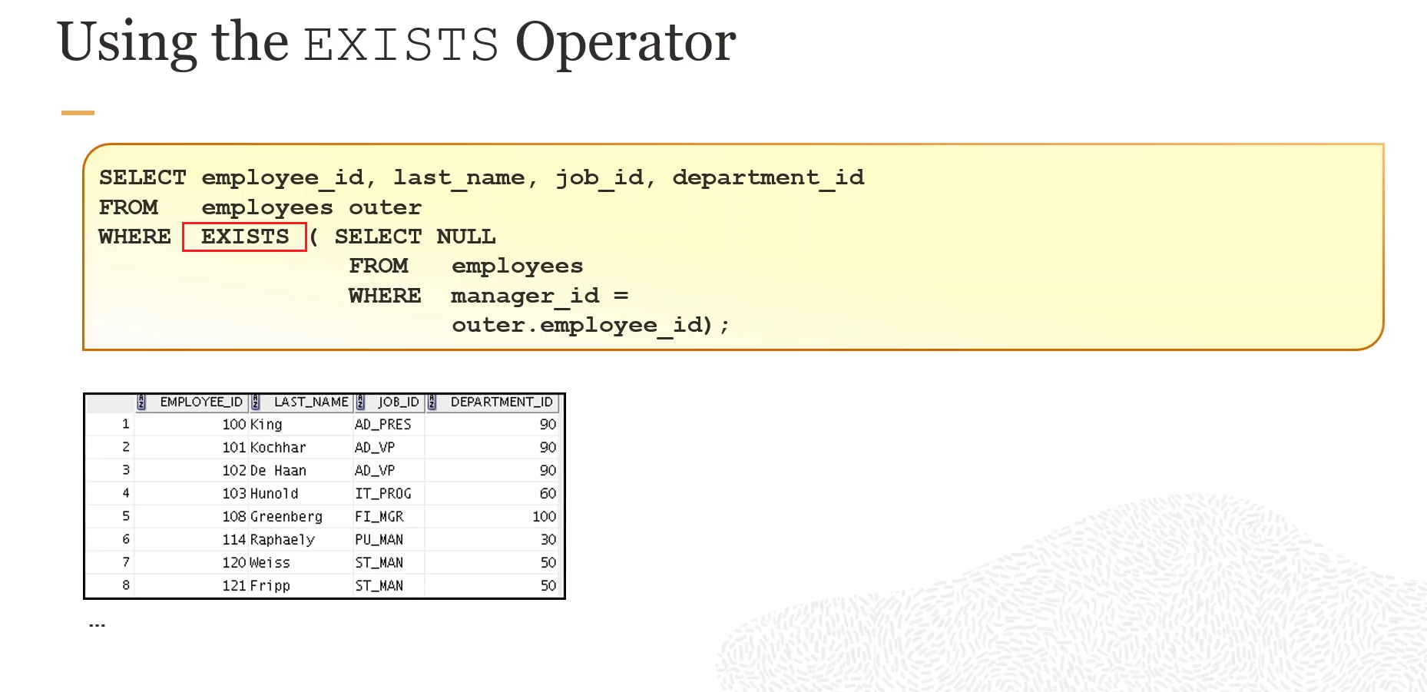

Slide 23
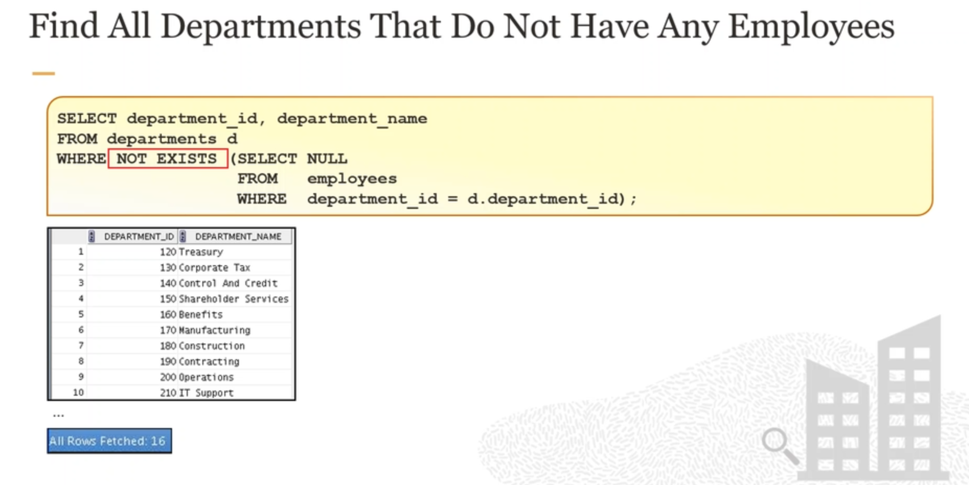

Slide 24
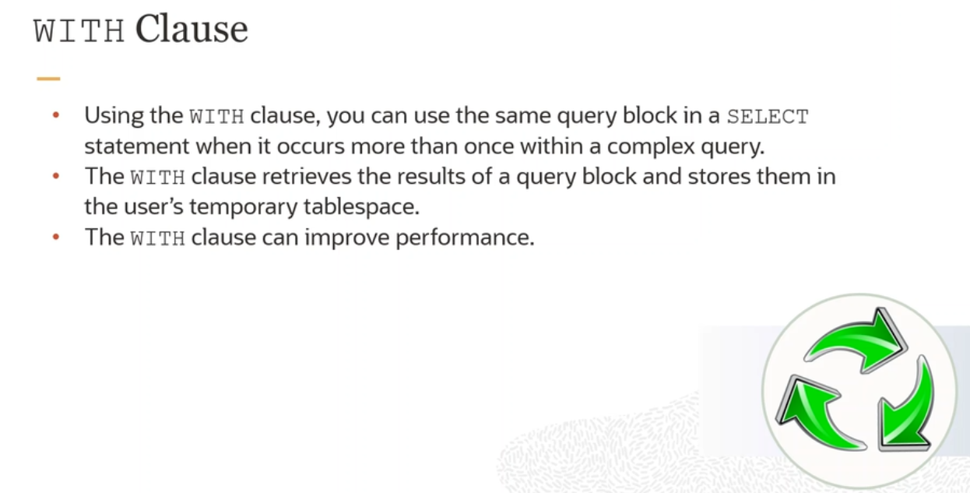

Slide 25
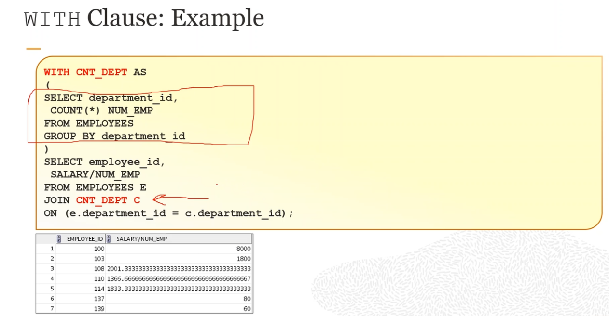

Slide 26
